Slide 1
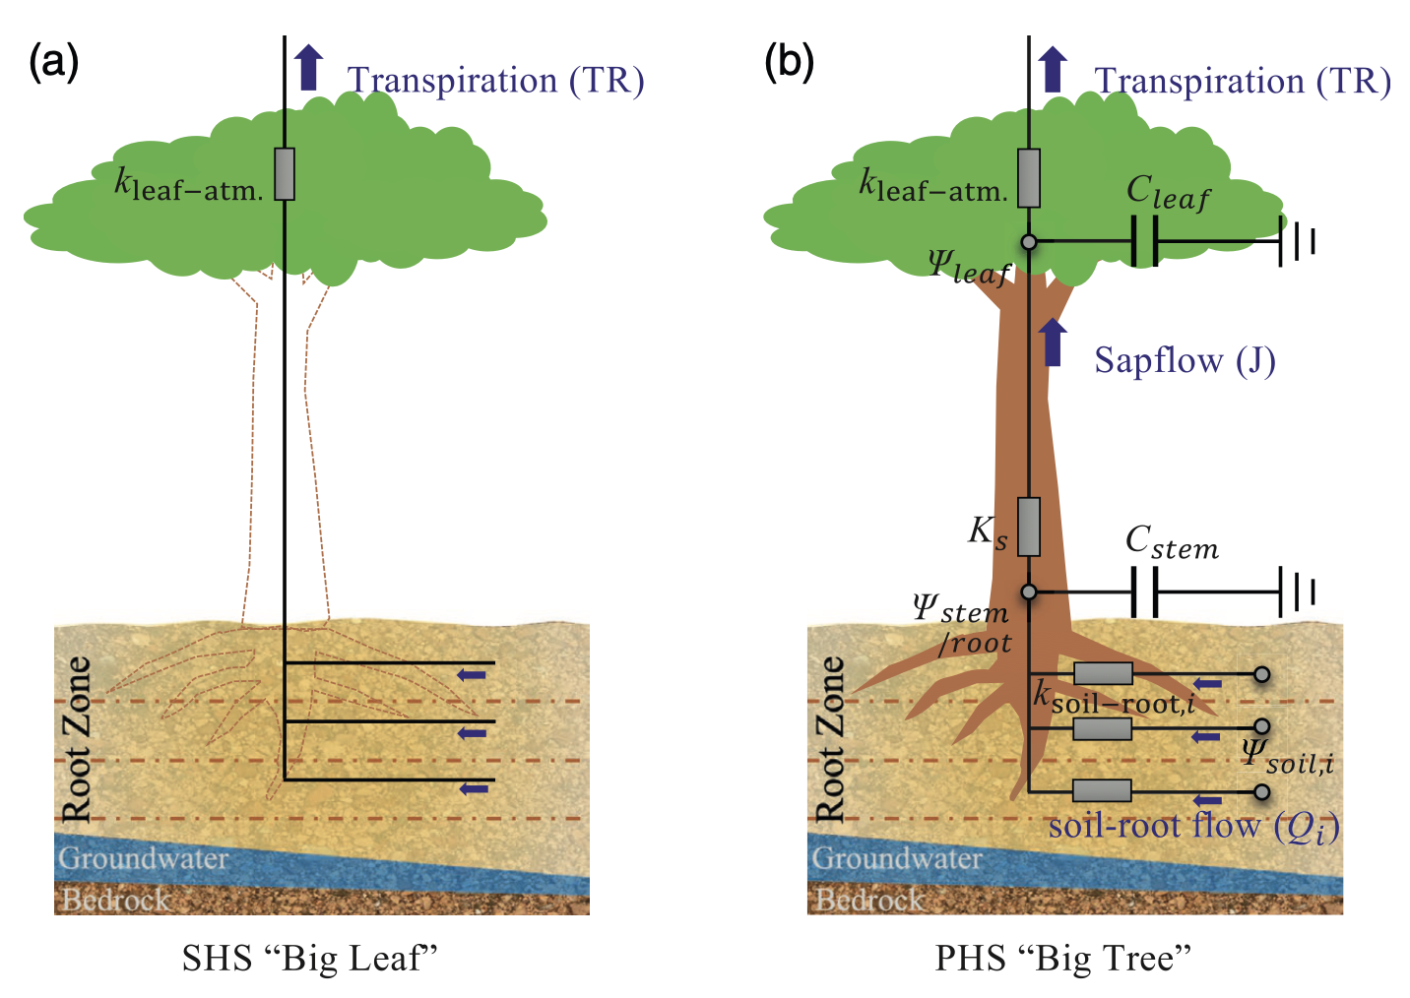
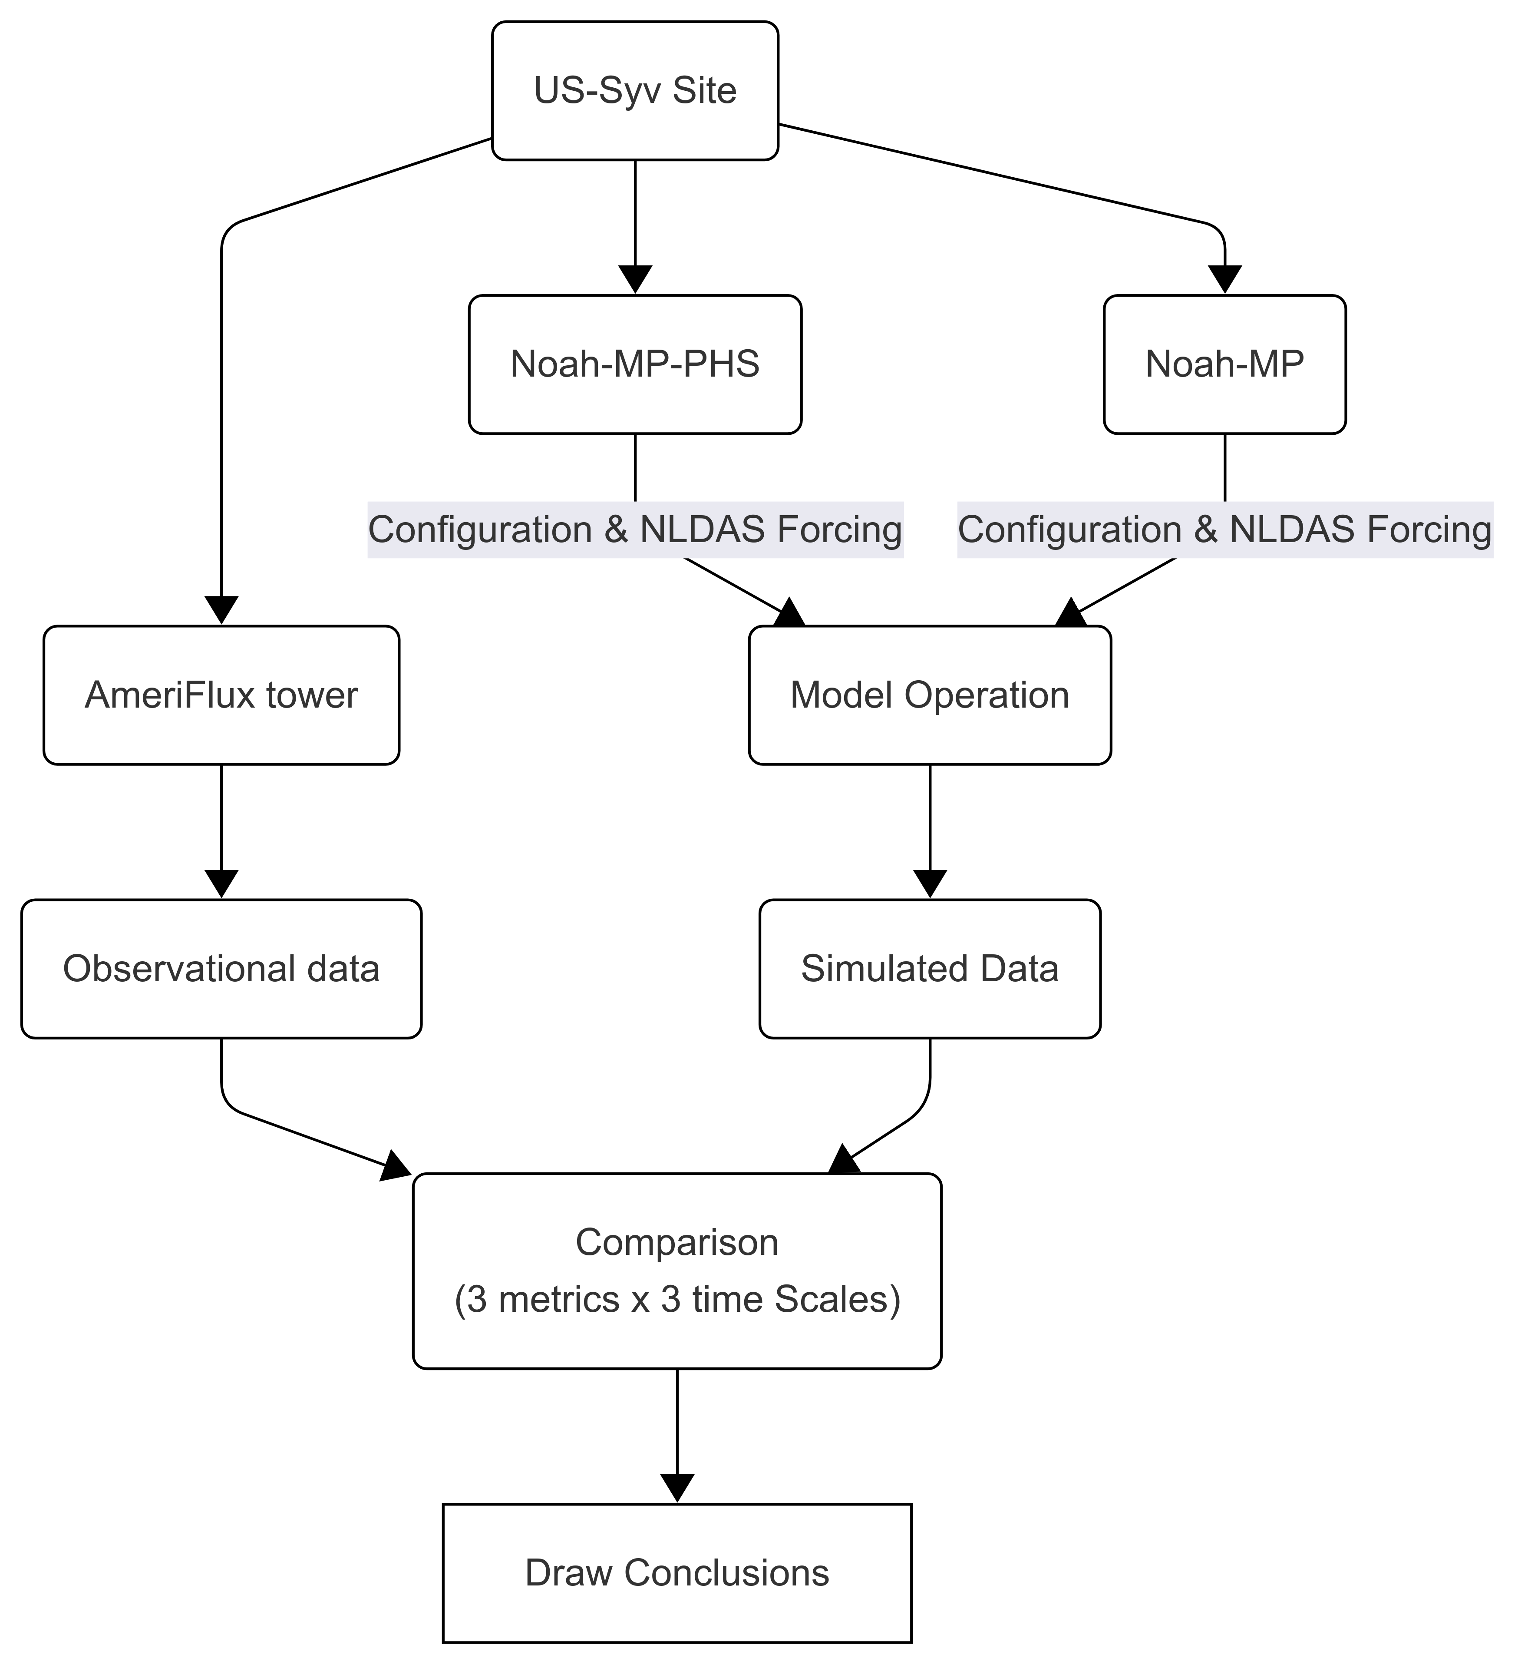
“Big Leaf” vs. “Big Tree”:
Does the Big Tree model better represent reality?
“Big Leaf”
Soil moisture
→
Carbon, water, energy simulations
→
Uncertainties
“Big Tree”
Soil moisture
<add> whole-plant hydraulics
→
Carbon, water, energy simulations
→
Uncertainties expect to reduce
Difference between the “Big leaf” and “Big tree” approach (extracted from Li et al., 2021).
Most land surface models, e.g.,
Noah-MP
New land surface models, e.g.,
Noah-MP-PHS
Notes:
Today I want to introduce a key idea in land surface modeling, the difference between the “Big Leaf” approach and the “Big Tree” approach. This distinction really shapes how we simulate water and carbon movement through ecosystems, which is important for understanding droughts, agriculture, and climate change.
You can think of a plant as a machine that moves water from the soil up through its body and releases it into the atmosphere, while taking in carbon from the air to grow. To represent this process, scientists use computer models, but how much detail those models include can change the results significantly.
Most traditional land surface models, like Noah-MP, use the “Big Leaf” concept. In this approach, we imagine the entire plant canopy as one giant leaf, and that big leaf responds directly to soil moisture without representing the plant’s internal structure. It doesn’t capture things like stems, roots, or detailed hydraulics, and instead relies on empirical formulas—essentially rules of thumb—to estimate water loss and carbon uptake. The problem is that this simplification introduces uncertainty, especially during droughts or other extreme conditions.
The “Big Tree” concept takes a much more realistic approach. Models like Noah-MP-PHS include whole-plant hydraulics, meaning they track water as it moves from the soil, through the roots, up the stem, and into the leaves. This framework includes physical properties like root conductance, stem capacitance, and sap flow, all of which describe how water moves and is stored inside the plant. By modeling the full hydraulic pathway, the Big Tree approach reduces uncertainty and gives us a clearer picture of how plants respond to stress.
To test whether this new approach performs better, we use data from a real ecosystem site, US-Syv, which provides detailed measurements of water and carbon exchange. We run both models—Noah-MP and Noah-MP-PHS—and compare their outputs to observed data using several metrics across different timescales. This comparison helps us determine whether the Big Tree model truly represents reality more accurately.
So why does any of this matter? Understanding how plants interact with water is essential for predicting drought impacts, improving agricultural management, and producing better climate forecasts. A model that incorporates realistic plant hydraulics can dramatically reduce simulation errors and improve our ability to predict what’s happening in nature.
That’s the big picture. The Big Leaf model offers simplicity, but at the cost of accuracy. The Big Tree model provides a more complete representation of plant water transport, which can make a meaningful difference in forecasting ecosystem behavior. I’m happy to take any questions you might have!

